Slide 1
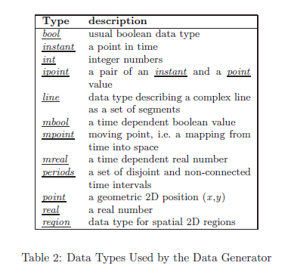
Data Type

Slide 2
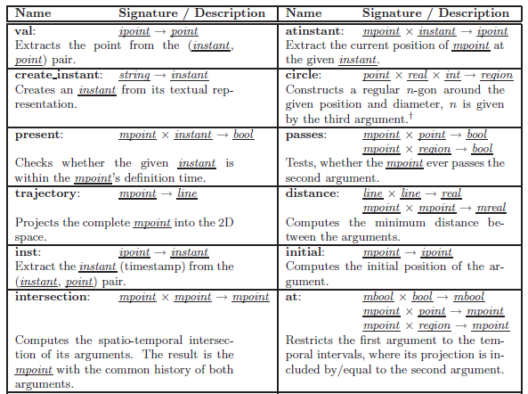
Operator Descriptions (1)

Slide 3
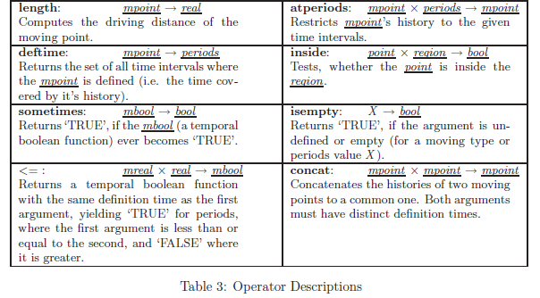
Operator Descriptions (2)

